Slide 1
Business Intelligence Concepts, Tools, and Applications
Week 4: Business Performance Management Systems
Lesson 3: Balanced Scorecards and Six Sigma

Slide 2
Scorecards, Dashboards, and Six Sigma
Learning Objectives
Identify four balanced scorecard perspectives
Comprehend the differences between dashboards and scorecards
Understand benefits of using balanced scorecard
Understand the benefits of using six sigma
Notes:
Tools Used for Performance Measurement
KPIs (Key Performance Indicators); KPI represents a strategic objective and metrics that measure performance against a goal
Balanced Scorecard
Six Sigma

Slide 3
Balanced Scorecard
Scorecards enable organizations to improve processes and reduce costs by:
Aligning strategy, plans, targets, and forecasts by creating a consolidated, strategic view of existing data
Communicating the strategy, improving the collaboration and management process in general, and creating a dynamic and effective environment that supports initiatives
Driving execution through accountability and performance measurement
Source: Adopted from Vasiliu, A. Dashboards and Scorecards: Linking Management Reporting to Execution, Hyperion Solutions )
Notes:
Source: adopted from Vasiliu, A. Dashboards and Scorecards: Linking Management Reporting to Execution Hyperion Solutions

Slide 4
Differences between dashboards and Scorecards
Scorecards are used by executives, managers, and staff
to monitor strategic alignment and success with strategic objectives and targets.
Dashboards are mostly used at the strategic, operational and tactical levels.
to monitor detailed operational performance on a weekly, daily, or even hourly basis.
Notes:
Source What is balanced Scorecards: http://web.archive.org/web/20140620093448/http://2gc.eu/files/2GC-FAQ1-What_is_a_Balanced_Scorecard_140616.pdf

Slide 5
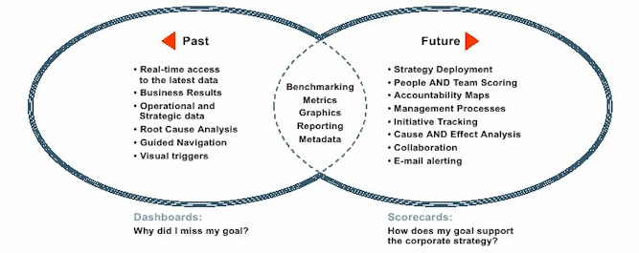
Dashboards and Scorecards Overview
Source: Adopted from Vasiliu, A. Dashboards and Scorecards: Linking Management Reporting to Execution, Hyperion Solutions
Notes:
Source Andreea Vasiliu, (2006) Dashboards and Scorecards: Linking Management Reporting to Execution , Hyperion Solutions (Links to an external site.)

Slide 6
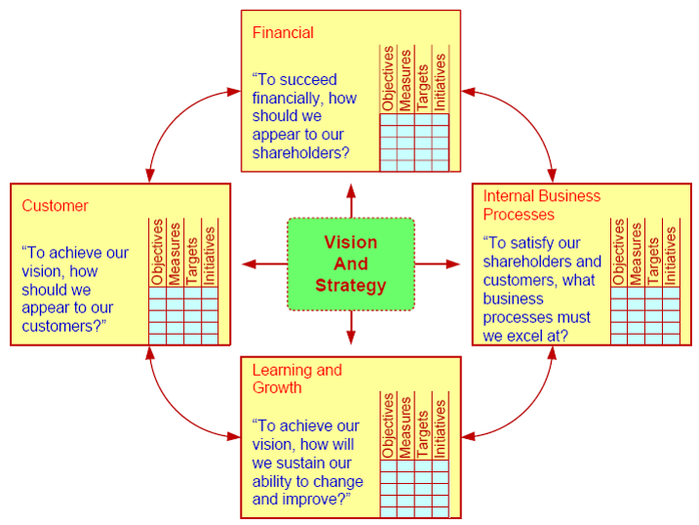
Balanced Scorecard
From SHARDA, RAMESH; DELEN, DURSUN; TURBAN, EFRAIM, BUSINESS INTELLIGENCE AND ANALYTICS: SYSTEMS FOR DECISION SUPPORT, 10th Edition, © 2015. Used by permission of Pearson Education, Inc., New York, NY. All Rights Reserved.
Notes:
Source: Adopted from Sharda, R. Delen, D. and Turban, E. (2015), Business Intelligence and Analytics: Systems for Decision Support, 10 ED, Pearson Education Inc.

Slide 7
Balanced Scorecard (BSC)
Four perspectives:
Customer:
To achieve our vision how we should appear to our customers?
Financial:
To succeed financially, how should we appear to our stakeholders?
Internal business processes:
To satisfy our stakeholders, and customers, what business processes must we excel at?
Learning and growth:
To achieve our vision, how will we sustain our ability to change and improve?
From SHARDA, RAMESH; DELEN, DURSUN; TURBAN, EFRAIM, BUSINESS INTELLIGENCE AND ANALYTICS: SYSTEMS FOR DECISION SUPPORT, 10th Edition, © 2015. Used by permission of Pearson Education, Inc., New York, NY. All Rights Reserved.
Notes:
From SHARDA, RAMESH; DELEN, DURSUN; TURBAN, EFRAIM, BUSINESS INTELLIGENCE AND ANALYTICS: SYSTEMS FOR DECISION SUPPORT, 10th Edition, © 2015. Used by permission of Pearson Education, Inc., New York, NY. All Rights Reserved.

Slide 8
Strategy Map and Balanced Scorecard
 | Strategy Map: Linked objectives | Balanced Scorecards: Measures | Balanced Scorecards: Targets | Strategic Initiatives: Action Plans
Financial |  | Net income growth | Increase 25%
Customer |  | Maintenance retention rate | Increase 15% | Change licensing and maintenance contact
Process |  | Issue turnaround time | Improve 30% | Standardized call center processes
Learning and Growth |  | Voluntary turnover rate | Reduce 25% | Salary and bonus upgrade
Increase net income
Increase Customer Retention
Improve Call Center Performance
Reduce Employee Turnover
From SHARDA, RAMESH; DELEN, DURSUN; TURBAN, EFRAIM, BUSINESS INTELLIGENCE AND ANALYTICS: SYSTEMS FOR DECISION SUPPORT, 10th Edition, © 2015. Used by permission of Pearson Education, Inc., New York, NY. All Rights Reserved.
Notes:
From SHARDA, RAMESH; DELEN, DURSUN; TURBAN, EFRAIM, BUSINESS INTELLIGENCE AND ANALYTICS: SYSTEMS FOR DECISION SUPPORT, 10th Edition, © 2015. Used by permission of Pearson Education, Inc., New York, NY. All Rights Reserved.

Slide 9
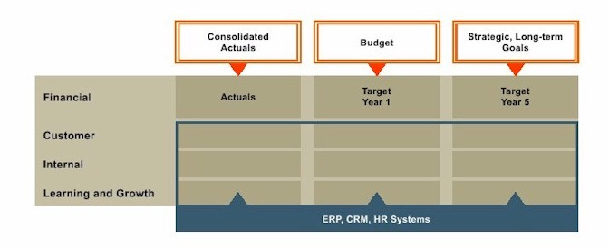
Building Scorecard
Source: Adopted from Dashboards and Scorecards: Linking Management Reporting to Execution., Hyperion Solutions (Links to an external site.)
Notes:
Source Andreea Vasiliu (2006) , Dashboards and Scorecards: Linking Management Reporting to Execution by Hyperion Solutions (Links to an external site.)

Slide 10
Software tools
Many Balanced Scorecards are reported via ad-hoc methods based around email, phone calls and office software.
In more complex organizations, balanced scorecard reporting software (BI tools ) is used to automate the production and distribution of these reports.

Slide 11
The BSC benefits
Providing executives with a consolidated and strategic view of plans, budgets, and forecasts
Alerting executives when initial performance signs reveal problems.
Aligning the organization towards a common strategy
Isolating and reducing inefficiencies in customer and product strategies
Tying performance measures and non-financial targets
Increasing buy-in from decision makers
In-depth insight into real-time financial and operational results
From SHARDA, RAMESH; DELEN, DURSUN; TURBAN, EFRAIM, BUSINESS INTELLIGENCE AND ANALYTICS: SYSTEMS FOR DECISION SUPPORT, 10th Edition, © 2015. Used by permission of Pearson Education, Inc., New York, NY. All Rights Reserved.
Notes:
From SHARDA, RAMESH; DELEN, DURSUN; TURBAN, EFRAIM, BUSINESS INTELLIGENCE AND ANALYTICS: SYSTEMS FOR DECISION SUPPORT, 10th Edition, © 2015. Used by permission of Pearson Education, Inc., New York, NY. All Rights Reserved.

Slide 12
Six Sigma
A performance management methodology aimed at reducing the number of defects in a business process to as close to zero defects per million opportunities (DPMO) as possible.
In numeric terms, the norm has been 6,200 to 67,000 DPMO.
This level of variability represents a three- to four-sigma level of performance.
To achieve a Six Sigma level of performance, the company would have to reduce the number of defects to no more than 3.4 DPMO.
From SHARDA, RAMESH; DELEN, DURSUN; TURBAN, EFRAIM, BUSINESS INTELLIGENCE AND ANALYTICS: SYSTEMS FOR DECISION SUPPORT, 10th Edition, © 2015. Used by permission of Pearson Education, Inc., New York, NY. All Rights Reserved.
Notes:
From SHARDA, RAMESH; DELEN, DURSUN; TURBAN, EFRAIM, BUSINESS INTELLIGENCE AND ANALYTICS: SYSTEMS FOR DECISION SUPPORT, 10th Edition, © 2015. Used by permission of Pearson Education, Inc., New York, NY. All Rights Reserved.

Slide 13
Comparison of Balanced Scorecard and Six Sigma
Balanced Scorecard | Six Sigma
Strategic management system | Performance measurement system
Relates to the longer-term view of the business | Provides snapshot of business’s performance and identifies measures that drive performance toward profitability
Designed to develop balanced set of measures | Designed to identify a set of measurements that impact profitability
Identifies measurements around vision and values | Establishes accountability for leadership for wellness and profitability
Critical management processes are to clarify vision/strategy, communicate, plan, set targets, align strategic initiatives, and enhance feedback | Includes all business processes-management and operational
Balances customer and internal operations without a clearly defined leadership role | Balances management and employees' roles, balances costs and revenue of heavy processes
Source: Adopted from P. Gupta, Six Sigma Business Scorecard, 2nd ed., McGraw-Hill Professional, New York, 2006.
Notes:
Source: adopted from P. Gupta, Six Sigma Business Scorecard, 2nd ed., McGraw-Hill Professional, New York, 2006.

Slide 14
Corporate Performance Measurement Portals, Scorecards, Dashboards
provides a container for several pieces to plug into so that the aggregate tells a story.
For example, a balanced scorecard that displays portlets for financial metrics combined with organizational learning and growth metrics.

